Slide 1
Printed Circuit Board (PCB) Designing

Slide 2
Contents
What is a Printed Circuit Board?
How do you design a PCB?
How do you order a custom PCB?

Slide 3
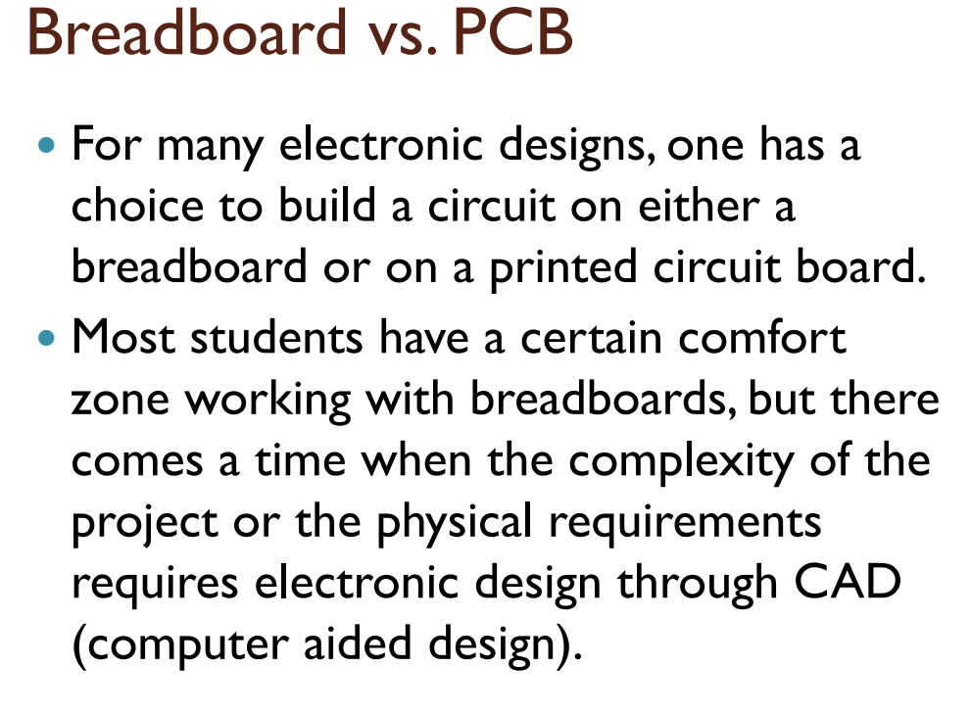

Slide 4
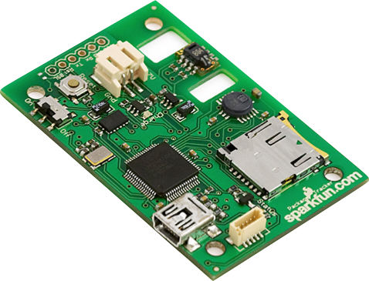
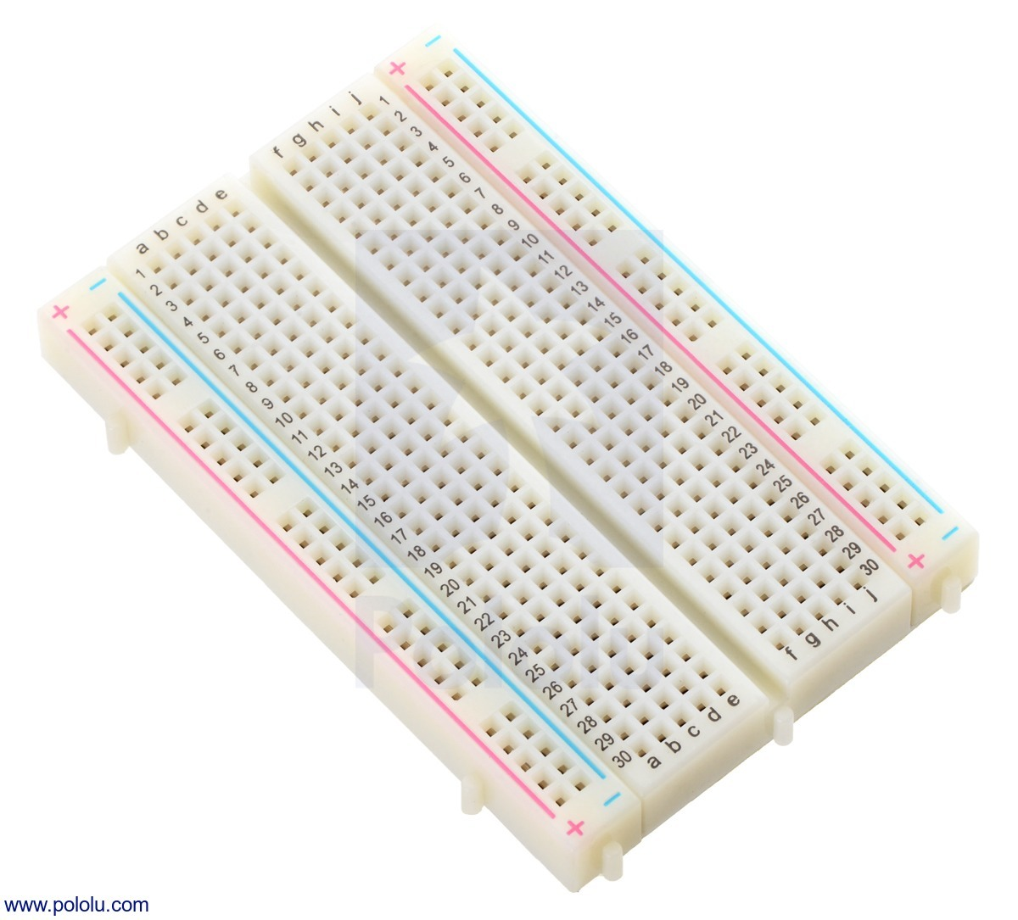

Slide 5
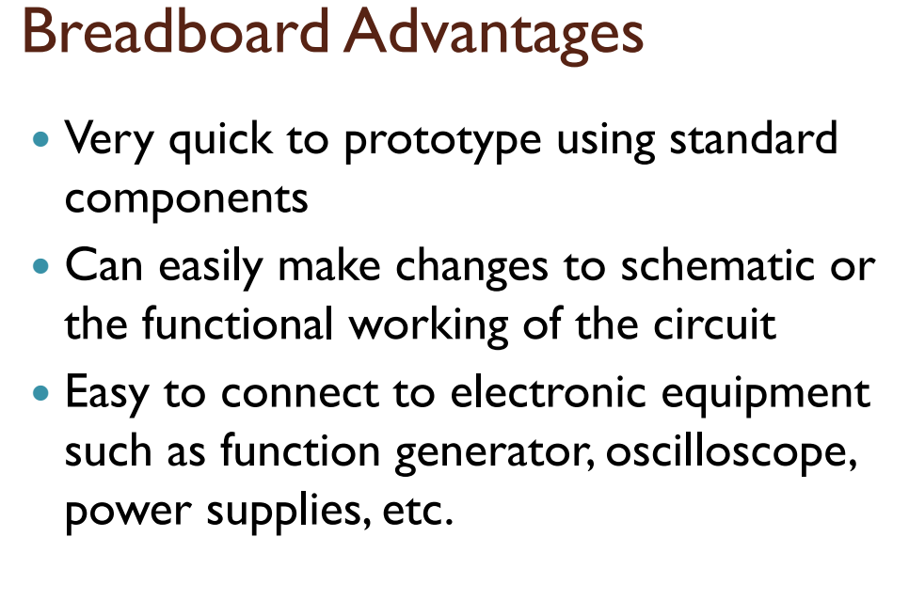

Slide 6
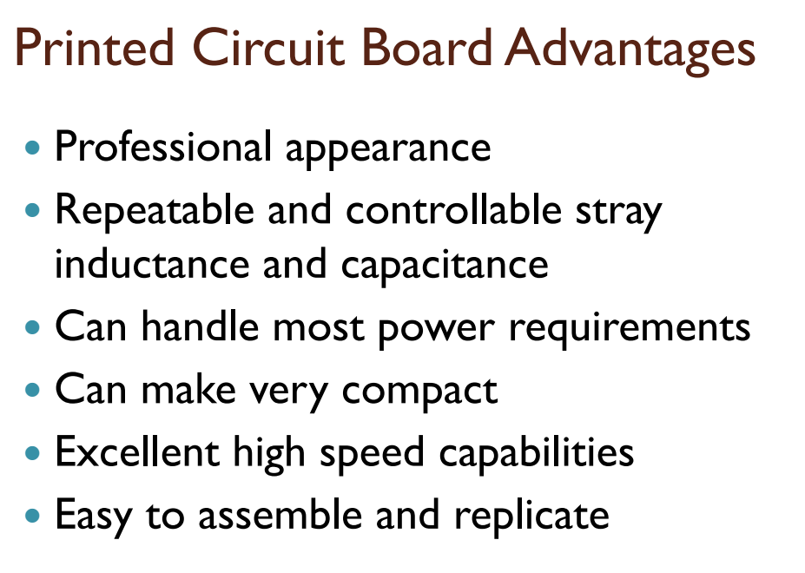

Slide 7
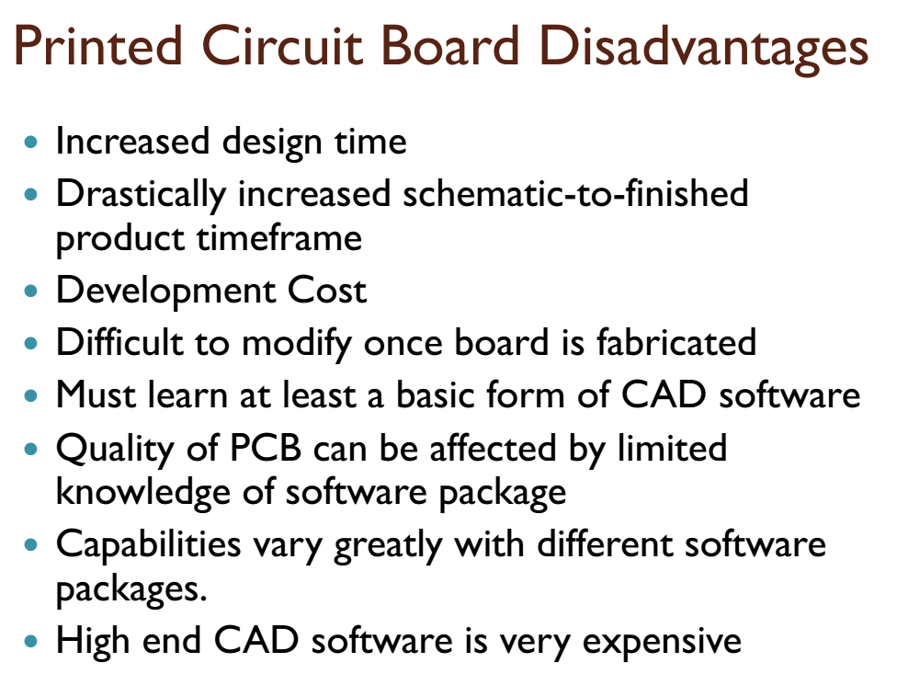

Slide 8

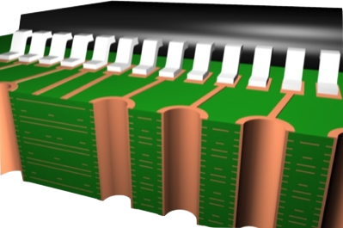
What is a PCB?
Layers, Traces, Planes, and Vias
8

Slide 9



Component Suppliers
Where do we get the goods?
For the “weird & wonderful” -
For the “inexpensive everyday” -
For the board itself -
www.mouser.com

Slide 10
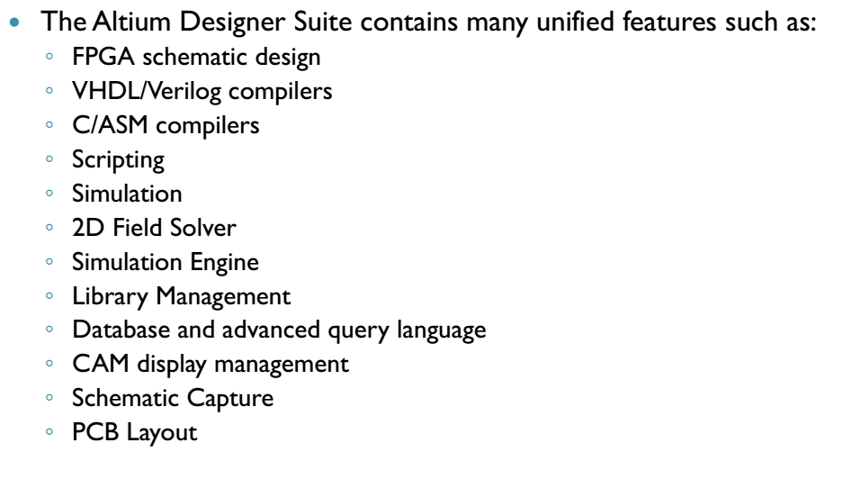
Altium Designer

Slide 11
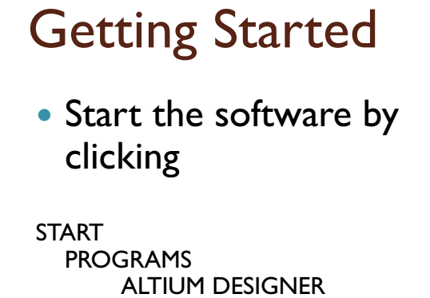
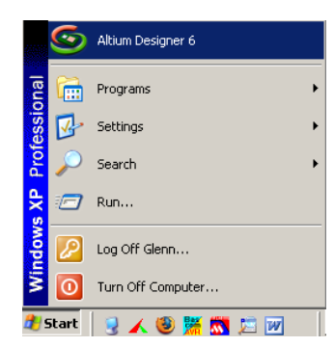
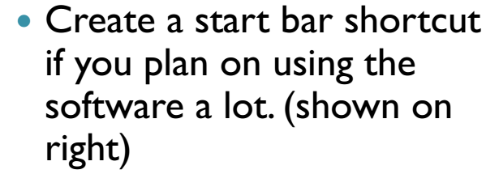

Slide 12
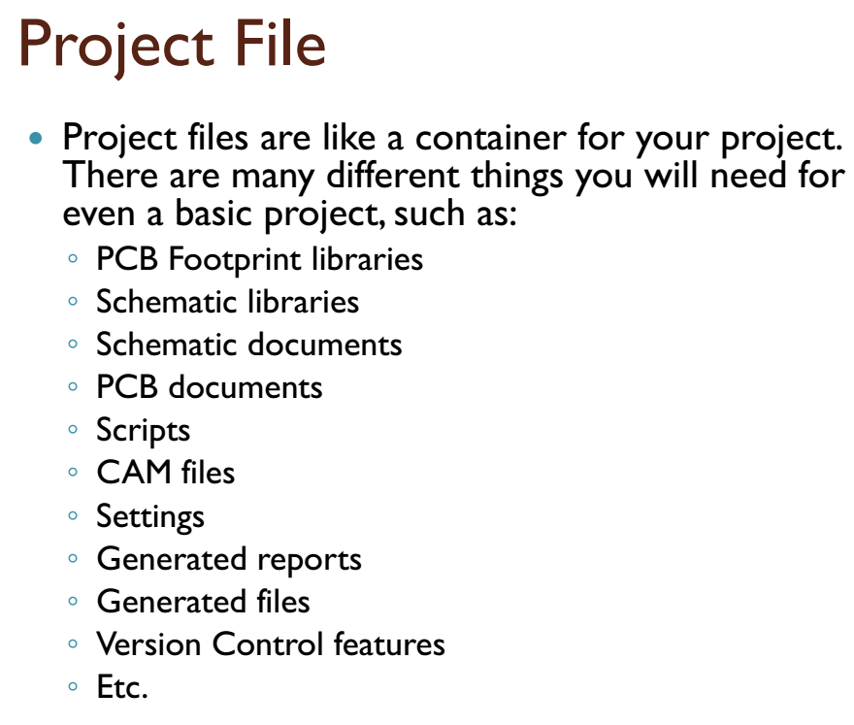

Slide 13
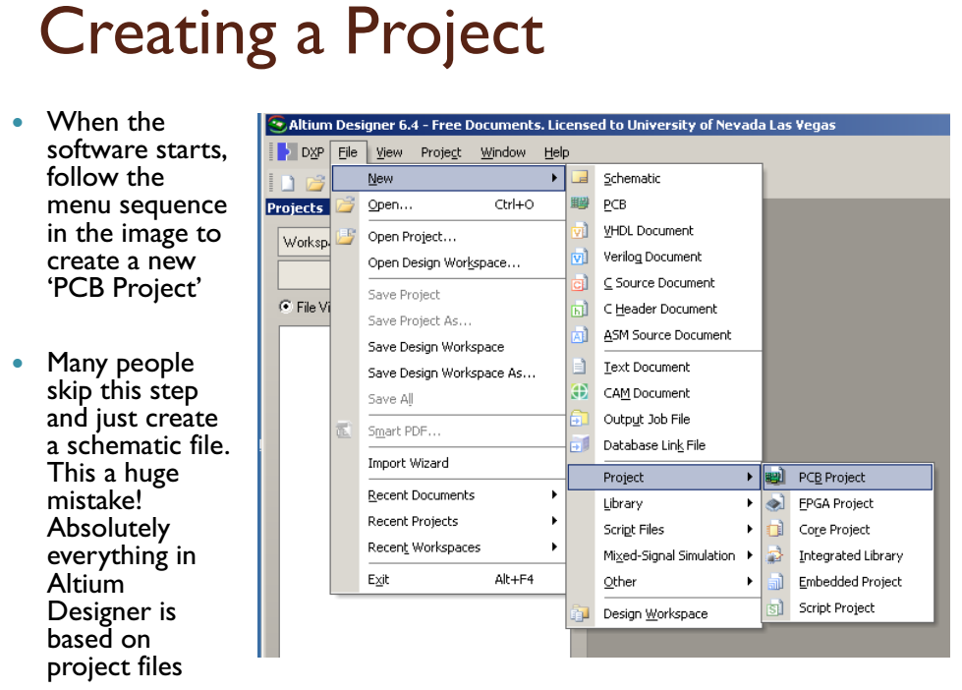

Slide 14
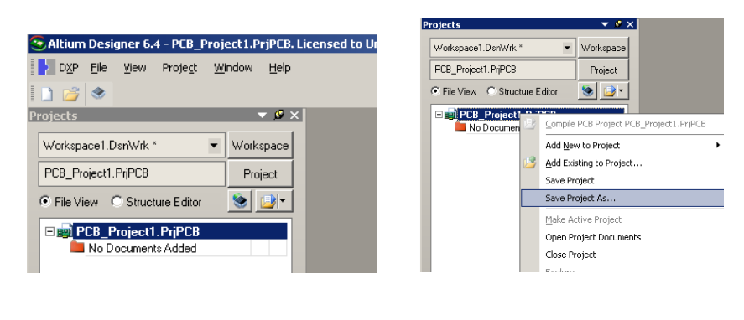
Project Name

Slide 15
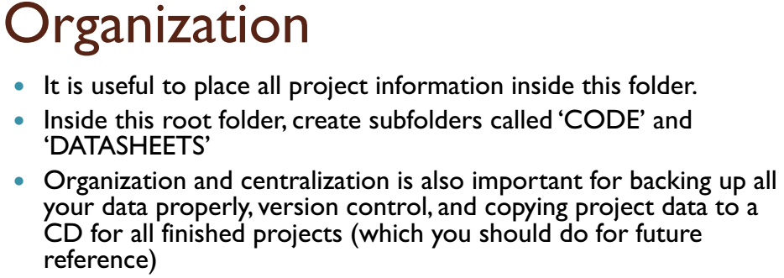
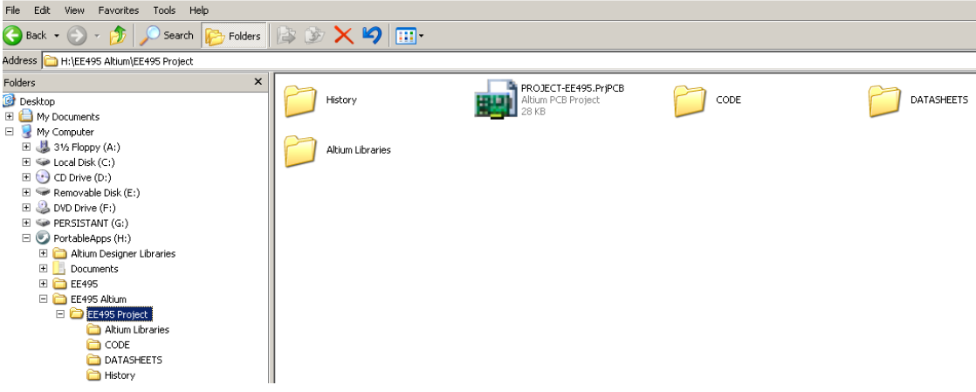

Slide 16
The PCB Design Process
From Vision To Reality
Schematic Capture
Place Components
Iteration
Route Traces
Generate Gerbers
16

Slide 17

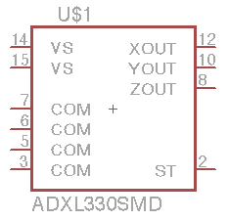
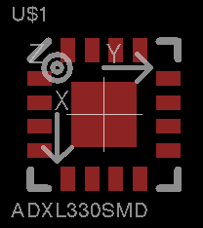
Eagle PCB
Symbol + Footprint + Device = Component
Symbol
Sym
Footprint
Pac
Device
Dev
17

Slide 18




Place Components
Beware of physical fit
Actives - lots of packaging alternatives
But before you do ...
Thru-Hole (TH)
Surface Mount (SMT)
DIP
LQFP, QFP, TQFP
QFN
BGA
18

Slide 19
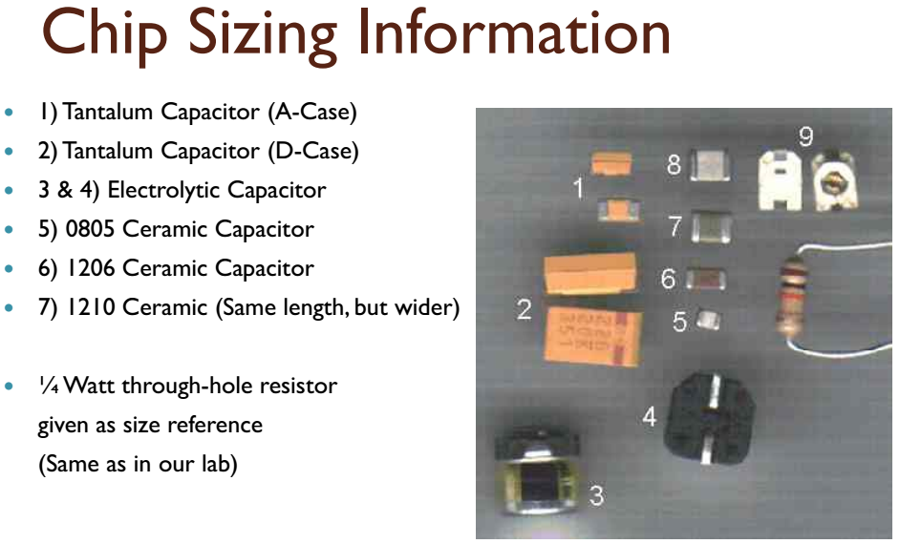

Slide 20
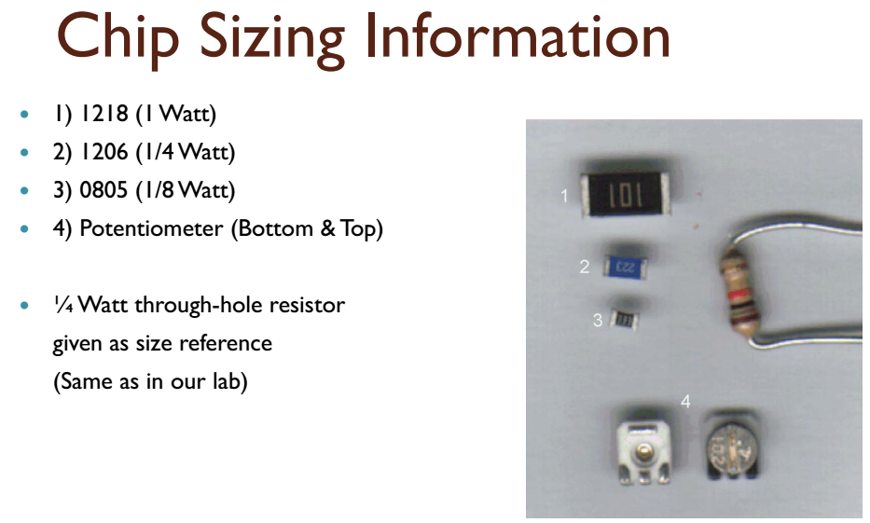

Slide 21
